Slide 1
Chapter 16
How to work
with objects

Slide 2
Objectives (part 1)
Applied
Use object literals to create objects that have properties and methods.
Use classes to create objects that have properties and methods.
Use the properties and methods of the objects you create.
Use JavaScript libraries in your applications.
Knowledge
Distinguish between creating objects with object literals and creating objects with classes.
Distinguish between the concise method syntax for coding methods and the traditional syntax.
Explain how two variables can refer to the same object.
Distinguish between data properties and accessor properties.

Slide 3
Objectives (part 2)
Describe how getters and setters work with read-only and write-only properties.
Describe the creation, use, and benefits of JavaScript libraries.
Describe how you can use a class to define objects that have properties and methods.
Describe the inheritance hierarchy for these JavaScript object types: Object, String, Number, Boolean, Date, Array, and Function.
Distinguish between inheritance and object composition and describe when you would use each technique.
Distinguish between a class-based language and a prototypal language.
Describe how to use a symbol and a generator function to create an iterator for an object.

Slide 4
Objectives (part 3)
Describe the creation and use of cascading methods.
Describe how you can use destructuring to assign the values stored in an object to individual variables or constants.

Slide 5
How to initialize a new object with an object literal
const invoice = {};
How to initialize a new object
with properties and methods
const invoice = {
taxRate: 0.0875, // property
getTotal(subtotal) { // method
const salesTax = subtotal * this.taxRate;
// this = the object
return subtotal + salesTax;
}
};

Slide 6
How to use dot notation to refer to an object’s properties and methods
console.log(invoice.taxRate); // displays 0.0875
const total = invoice.getTotal(100); // total is 108.75

Slide 7
How to nest objects
const invoice = {
terms: {
dueDays: 30,
description: "Net due 30 days"
}
};
How to use dot notation to refer to nested objects
console.log(invoice.terms.dueDays);
// displays 30
console.log(invoice.terms.description);
// displays 'Net due 30 days'

Slide 8
Terms related to object literals
object literal
property
method
nested object

Slide 9
Two ways to code a method
Using traditional syntax
const invoice = {
getTotal: function(subtotal, taxRate) {
return subtotal + (subtotal * taxRate);
}
};
Using concise method syntax
const invoice = {
getTotal(subtotal, taxRate) {
return subtotal + (subtotal * taxRate);
}
};

Slide 10
Two ways to initialize a property to a variable or constant
Two variables
let name = "Grace";
let year = 2021;
Using traditional syntax
const person = {
name: name,
year: year
};
Using shorthand properties
const person = {
name,
year
};

Slide 11
How to add properties and methods to an object
// create an object
const invoice = {};
// add a property
invoice.taxRate = 0.0875;
// add a method
invoice.getSalesTax(subtotal) {
return (subtotal * this.taxRate);
};
How to modify the value of a property
invoice.taxRate = 0.095;
How to remove a property from an object
delete invoice.taxRate;
console.log(invoice.taxRate); // displays undefined

Slide 12
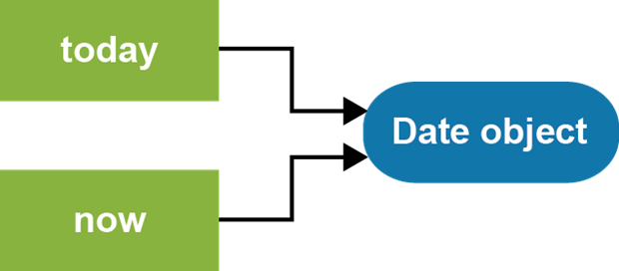
Two constants that refer to the same object
const today = new Date();
const now = today;
today.setFullYear(1968);
console.log(now.getFullYear()); // displays 1968
A diagram that illustrates these references

Slide 13
An object with an accessor property named fullName
const person = {
firstName: "Grace",
lastName: "Hopper",
get fullName() {
return `${this.firstName} ${this.lastName}`;
},
set fullName(val) {
const names = val.split(" ");
if(names && names.length === 2) {
this.firstName = names[0];
this.lastName = names[1];
}
else {
throw new TypeError(
"fullName must include first and " +
"last name.");
}
}
};

Slide 14
Code that uses the accessor property
console.log(person.fullName); // displays "Grace Hopper"
person.fullName = "Ada Lovelace";
console.log(person.firstName); // displays "Ada"
console.log(person.lastName); // displays "Lovelace"
console.log(person.fullName); // displays "Ada Lovelace"

Slide 15
Terms related to methods and properties
concise method syntax
shorthand property notation
delete operator
reference to an object
data property
accessor property
getter
setter
read-only property
write-only property

Slide 16
The benefits of JavaScript libraries
They let you group similar functionality in a single file.
They make your code easier to understand, maintain, and reuse.
They encourage the separation of concerns.

Slide 17
The lib_mpg.js file
const mpg = {
miles: 0,
gallons: 0,
calculate() {
return this.miles / this.gallons;
}
};

Slide 18
How to include and use JavaScript libraries in your application
In the index.html file
<body>
...
<script
src="https://code.jquery.com/jquery-3.4.1.min.js">
</script>
<script src="lib_mpg.js"></script>
<script src="main.js"></script>
</body>
In the main.js file
$(document).ready( () => {
$("#calculate").click( () => {
mpg.miles = parseFloat($("#miles").val());
mpg.gallons = parseFloat($("#gallons").val());
$("#mpg").val(mpg.calculate().toFixed(1));
});
});

Slide 19
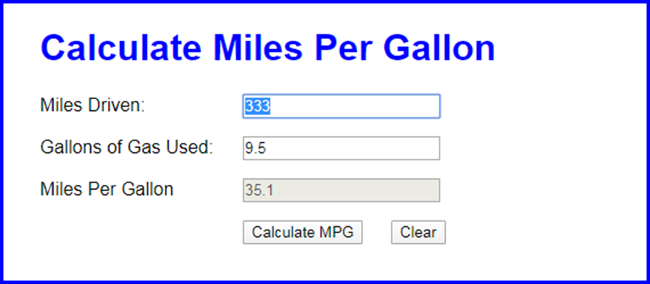
The Miles Per Gallon application

Slide 20
The HTML for the MPG application (part 1)
<body>
<main>
<h1>Calculate Miles Per Gallon</h1>
<div>
<label for="miles">Miles Driven:</label>
<input type="text" id="miles">
</div>
<div>
<label for="gallons">Gallons of Gas Used:
</label>
<input type="text" id="gallons">
</div>
<div>
<label for="mpg">Miles Per Gallon</label>
<input type="text" id="mpg" disabled>
</div>

Slide 21
The HTML for the MPG application (part 2)
<div>
<label></label>
<input type="button" id="calculate"
value="Calculate MPG">
<input type="button" id="clear"
value="Clear">
</div>
</main>
<script
src="https://code.jquery.com/jquery-3.4.1.slim.min.js">
</script>
<script src="lib_mpg.js"></script>
<script src="mpg.js"></script>
</body>
</html>

Slide 22
The lib_mpg.js file for the MPG application
"use strict";
const mpg = {
miles: 0,
gallons: 0,
get isValid() {
if (isNaN(this.miles) || isNaN(this.gallons)) {
return false;
}
else if (this.miles <= 0 || this.gallons <= 0) {
return false;
}
else {
return true;
}
},
calculate() {
return this.miles / this.gallons;
}
};

Slide 23
The mpg.js file for the MPG application (part 1)
"use strict";
$(document).ready( () => {
$("#calculate").click( () => {
mpg.miles = parseFloat($("#miles").val());
mpg.gallons = parseFloat($("#gallons").val());
if (mpg.isValid) {
$("#mpg").val(mpg.calculate().toFixed(1));
$("#miles").select();
} else {
alert("Both entries must be numeric " +
"and greater than zero.");
$("#miles").focus();
}
});

Slide 24
The mpg.js file for the MPG application (part 2)
$("#clear").click( () => {
$("#miles").val("");
$("#gallons").val("");
$("#mpg").val("");
$("#miles").focus();
});
$("#miles").focus();
});

Slide 25
How to use a class to define an object type
The Invoice class
class Invoice {
constructor() {
this.subtotal = null;
this.taxRate = null;
}
getTotal() {
const salesTax = this.subtotal * this.taxRate
return this.subtotal + salesTax;
}
}

Slide 26
How to create and use an Invoice object
const invoice = new Invoice();
invoice.subtotal = 100;
invoice.taxRate = 0.0875;
total = invoice.getTotal(); // total is 108.75
Code that attempts to create an Invoice object without the new keyword
const invoice = Invoice();
// throws a TypeError exception

Slide 27
How to add parameters to the constructor for the Invoice type
class Invoice {
constructor(subtotal, taxRate) {
this.subtotal = subtotal;
this.taxRate = taxRate;
}
getTotal() { /* same as before */ }
}
How to pass arguments to the constructor
const invoice = new Invoice(100, 0.0875);
total = invoice.getTotal(); // total is 108.75
How to create two Invoice objects that hold different data
const invoice1 = new Invoice(100, 0.0875);
const invoice2 = new Invoice(1000, 0.07);
const total1 = invoice1.getTotal(); // total1 is 108.75
const total2 = invoice2.getTotal(); // total2 is 1070

Slide 28
Terms related to classes
class
constructor
instance of a class

Slide 29
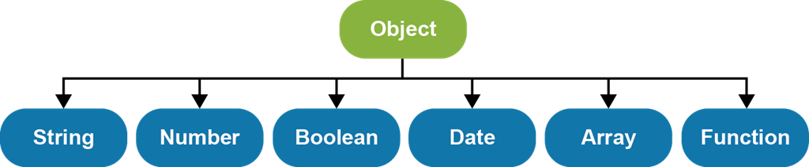
The JavaScript object hierarchy

Slide 30
The Person class
class Person {
constructor(fname, lname) {
this.firstName = fname;
this.lastName = lname;
}
get fullName() {
return `${this.firstName} ${this.lastName}`;
}
}
How to create and use a Person object
// create Person object
const p = new Person("Grace", "Hopper");
console.log(p.fullName); // displays "Grace Hopper"
console.log(p instanceof Object); // displays true
console.log(p instanceof Person); // displays true

Slide 31
An Employee class that inherits the Person class
class Employee extends Person {
constructor(fname, lname, hireDate) {
super(fname, lname);
this.hireDate = hireDate;
}
}
How to create and use an Employee object
const emp = new Employee(
"Bjarne", "Stroustrup", new Date("1/1/1979"));
console.log(emp.fullName);
// displays "Bjarne Stroustrup"
console.log(emp.hireDate.toDateString());
// displays "Mon Jan 01 1979"
console.log(emp instanceof Person); // displays true
console.log(emp instanceof Employee); // displays true

Slide 32
Terms related to inheritance
native object types
inheritance
inherit properties and methods
subclass
superclass
instanceof operator

Slide 33
A NumberArray class that uses inheritance
class NumberArray extends Array {
constructor() {
super();
// defines a new property
this.lastNumber = null;
}
// overrides an existing method
push(num) {
if(typeof num === "number") {
super.push(num);
this.lastNumber = num;
} else {
throw new TypeError(
"NumberArray can only store numbers");
}
}
}

Slide 34
How to create and use a NumberArray object that uses inheritance
const arr = new NumberArray();
arr.push(1.07);
arr.push(2.21);
arr.push(3.14);
// arr.push("Grace"); // Would throw TypeError
console.log(arr.lastNumber); // displays 3.14
console.log(arr.length); // displays 3
console.log(arr.toString()); // displays 1.07,2.21,3.14
arr.unshift("Grace"); // PROBLEM! stores invalid value
A problem with the NumberArray class
Not all inherited methods that add elements to the array check to make sure the element is a number. As a result, it’s possible to add invalid data to the NumberArray object.

Slide 35
It makes sense to use inheritance when…
One object is a type of another object.
Both classes are part of the same logical domain.
The subclass primarily adds features to the superclass.

Slide 36
A NumberArray class that uses object composition
class NumberArray {
constructor() {
this._numbers = []; // 'private' property
this.lastNumber = null;
}
get length() { // read-only property
return this._numbers.length;
}
push(num) { // method
if(typeof num === "number") {
this._numbers.push(num);
this.lastNumber = num;
} else {
throw new TypeError(
"NumberArray can only store numbers");
}
}
toString() { // method
return this._numbers.toString();
}
}

Slide 37
How to create and use a NumberArray object that uses object composition
const arr = new NumberArray();
arr.push(1.07);
arr.push(2.21);
arr.push(3.14);
// arr.push("Grace"); // Would throw TypeError
console.log(arr.lastNumber); // displays 3.14
console.log(arr.length); // displays 3
console.log(arr.toString()); // displays 1.07,2.21,3.14
// arr.unshift("Grace"); // Would throw TypeError
// because method isn't
// defined

Slide 38
It makes sense to use object composition when…
One object has a type of another object.
The subclass restricts access to features of the superclass.

Slide 39
Terms related to object composition
object composition
encapsulation
data hiding

Slide 40
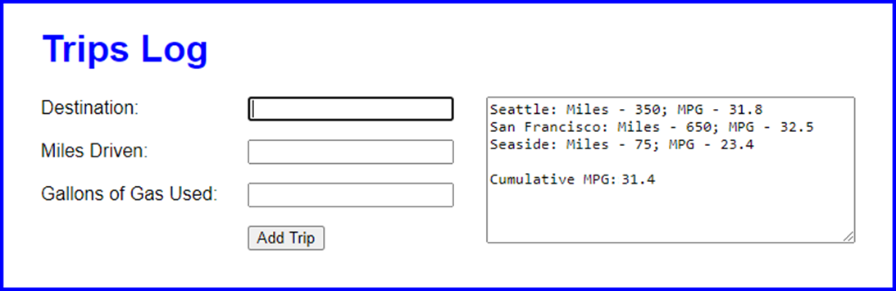
The Trips application

Slide 41
The HTML for the Trips application (part 1)
<body>
<main>
<h1>Trips Log</h1>
<div id="trips">
<textarea id="trip_list" rows="8" cols="42">
</textarea>
</div>
<div>
<label for="destination">Destination:</label>
<input type="text" id="destination">
</div>
<div>
<label for="miles">Miles Driven:</label>
<input type="text" id="miles">
</div>
<div>
<label for="gallons">Gallons of Gas Used:
</label>
<input type="text" id="gallons">
</div>

Slide 42
The HTML for the Trips application (part 2)
<div>
<label></label>
<input type="button" id="add_trip"
value="Add Trip">
</div>
</main>
<script
src="https://code.jquery.com/jquery-3.4.1.slim.min.js">
</script>
<script src="lib_trips.js"></script>
<script src="trips.js"></script>
</body>

Slide 43
Some of the CSS for the Trips application
#trips {
float: right;
}

Slide 44
The lib_trips.js file for the Trips app (part 1)
"use strict";
class Trip {
constructor(destination, miles, gallons) {
this.destination = destination;
this.miles = parseFloat(miles);
this.gallons = parseFloat(gallons);
}
get isValid() { // a read-only property
if (this.destination == "" || isNaN(this.miles) ||
isNaN(this.gallons)) {
return false;
} else if (this.miles <= 0 || this.gallons <= 0){
return false;
} else {
return true;
}
}
get mpg() { // a read-only property
return this.miles / this.gallons;
}

Slide 45
The lib_trips.js file for the Trips app (part 2)
toString() {
const mpg = this.mpg.toFixed(1);
return `${this.destination}: Miles - ${this.miles}; MPG - ${mpg}`;
}
}
class Trips {
constructor() {
this._trips = [];
}
push(trip) {
// only allow Trip objects to be added to array
if (trip instanceof Trip) {
this._trips.push(trip);
}
}
get totalMpg() { // a read-only property
let totalMiles = 0;
let totalGallons = 0;
for (let trip of this._trips) {
totalMiles += trip.miles;
totalGallons += trip.gallons;
}
return totalMiles / totalGallons;
}

Slide 46
The lib_trips.js file for the Trips app (part 3)
toString() {
let str = "";
for (let trip of this._trips) {
str += trip.toString() + "\n";
}
str += "\nCumulative MPG: " + this.totalMpg.toFixed(1);
return str;
}
}

Slide 47
The trips.js file for the Trips application (part 1)
"use strict";
$(document).ready( () => {
const trips = new Trips();
$("#add_trip").click( () => {
const trip = new Trip(
$("#destination").val(), $("#miles").val(),
$("#gallons").val());
if (trip.isValid) {
trips.push(trip);
$("#trip_list").val(trips.toString());
$("#destination").val("");
$("#miles").val("");
$("#gallons").val("");
$("#destination").focus();
}

Slide 48
The trips.js file for the Trips application (part 2)
else {
alert("Please complete all fields.\n" +
"Miles and gallons must be numeric " +
"and greater than zero.");
$("#destination").select();
}
});
$("#destination").focus();
});

Slide 49
Code that creates two instances of the Date type
const taxDay = new Date("4/15/2021");
const xmas = new Date("12/25/2021");
console.log(taxDay.toDateString()); // displays Thu Apr 15 2021
console.log(xmas.toDateString()); // displays Sat Dec 25 2021
Code that adds a method to the prototype object of the Date type
Date.prototype.toNumericDateString = function() {
const m = this.getMonth() + 1; // month is zero based
const d = this.getDate();
const y = this.getFullYear();
return m + "/" + d + "/" + y;
};
console.log(taxDay.toNumericDateString()); // displays 4/15/2021
console.log(xmas.toNumericDateString()); // displays 12/25/2021

Slide 50
Code that adds an own property to one instance of the Date type
taxDay.hasExtension = true;
console.log(taxDay.hasExtension); // displays true
console.log(xmas.hasExtension); // displays undefined

Slide 51
Code that uses an own property to override a prototype property
xmas.toDateString = function() {
return "It's Christmas Day";
};
console.log(taxDay.toDateString());
// displays Thu Apr 15 2021
console.log(xmas.toDateString());
// displays It's Christmas Day

Slide 52
Terms related to prototypes
prototype object
prototypal language
clone a prototype object
direct property
own property
override a method

Slide 53
A constructor function that creates Invoice objects
const Invoice = function(subtotal, taxRate) {
this.subtotal = subtotal;
this.taxRate = taxRate;
};
Code that adds a method
to the Invoice object prototype
Invoice.prototype.getTotal = function() {
const salesTax = this.subtotal * this.taxRate
return this.subtotal + salesTax;
};
Code that uses the constructor function
to create two Invoice objects
const invoice1 = new Invoice(100, 0.0875);
const invoice2 = new Invoice(1000, 0.07);
const total1 = invoice1.getTotal(); // total1 is 108.75
const total2 = invoice2.getTotal(); // total2 is 1070

Slide 54
A factory function that creates Invoice objects
const getInvoice = function(subtotal, taxRate) {
const invoicePrototype = { // define prototype methods
getTotal: function() {
const salesTax = this.subtotal * this.taxRate
return this.subtotal + salesTax;
}
};
const invoice = Object.create(invoicePrototype);
invoice.subtotal = subtotal;
invoice.taxRate = taxRate;
return invoice;
};
Code that uses a factory function
to create two Object types
const invoice1 = getInvoice(100, 0.0875);
const invoice2 = getInvoice(1000, 0.07);
const total1 = invoice1.getTotal(); // total1 is 108.75
const total2 = invoice2.getTotal(); // total2 is 1070

Slide 55
Terms related to legacy coding of objects
constructor function
factory function

Slide 56
How to use brackets to refer to properties and methods of an object
const invoice = {
taxRate: 0.0875, // property
getTotal(subtotal) { // method
return subtotal + subtotal * this.taxRate;
}
};
console.log(invoice.taxRate); // displays 0.0875
console.log(invoice["taxRate"]); // displays 0.0875
const total1 = invoice.getTotal(100); // total1 is 108.75
const total2 = invoice["getTotal"](100); // total2 is 108.75
// collides with getTotal()
invoice.getTotal = function(subtotal) {
return subtotal + subtotal * 0.10;
};
const total3 = invoice.getTotal(100); // total3 is 110.00
console.log(total3);

Slide 57
A symbol used as a computed property name
In an object
const taxRate = Symbol("taxRate");
const invoice = {
[taxRate]: 0.0875
};
invoice.taxRate = 0.07; // doesn't collide with taxRate symbol
console.log(invoice[taxRate]); // displays 0.0875
console.log(invoice.taxRate); // displays 0.07
In a class
const trips = Symbol("trips");
class Trips {
constructor() {
this[trips] = [];
}
// other methods that use the symbol named trips go here
}

Slide 58
Two of the well-known symbols
Symbol Method Name Description
Symbol.hasInstance @@hasInstance() Defines how an object behaves when used with the instanceof operator.
Symbol.iterator @@iterator() Defines how an object behaves when used with a for-of loop or with a spread operator that’s described in the next chapter.

Slide 59
One method required by an iterator object
Method Description
next() Executes the specified code and returns an IteratorResult object.
Two properties of the IteratorResult object
Property Description
done A Boolean value that indicates whether the iteration is done.
value The value of the current item in the sequence. Can be omitted when done is true.

Slide 60
An object literal that’s iterable
const taskList = {
tasks: [],
// methods of the taskList object go here
[Symbol.iterator]() { // define the iterator() method
return { // return the Iterator object
tasks: this.tasks,
index: 0,
next() { // required method of the Iterator object
if (this.index == this.tasks.length) {
return {done: true}; // IteratorResult
} else {
let value = this.tasks[this.index];
this.index++;
return {value, done: false}; // IteratorResult
}
}
};
}
};

Slide 61
A for-of loop that consumes the object
for (const task of taskList) {
console.log(task.description)
}

Slide 62
A keyword that’s used with generator functions
Keyword Description
yield Returns an IteratorResult object and pauses execution.

Slide 63
An iterable object literal with a generator function
const taskList = {
tasks: [],
// methods of the taskList object go here
// define the iterator() method
*[Symbol.iterator]() {
for (let task of this.tasks) {
yield task;
}
}
};
A for-of loop that consumes the object
for (const task of taskList) {
console.log(task.description)
}

Slide 64
A Date object that’s iterable
Date.prototype[Symbol.iterator] = function*() {
yield this.getFullYear();
yield this.getMonth();
yield this.getDate();
yield this.getHours();
yield this.getMinutes();
yield this.getSeconds();
};
A for-of loop that consumes an iterable Date object
const now = new Date();
for (const part of now) {
console.log(part); // displays 6 date parts
}

Slide 65
Two methods that modify an object but don’t return the object
Two methods of the taskList object
const taskList = {
load() {
// load code goes here
},
add(task) {
// add code goes here
}
};
Chaining these method calls doesn’t work
taskList.load().add(task);
// TypeError: Cannot read property 'add' of undefined
The methods must be called one at a time
taskList.load();
taskList.add(task);

Slide 66
Two methods that modify an object and then return the object
Two methods of the taskList object
const taskList = {
load() {
// load code goes here
return this;
},
add(task) {
// add code goes here
return this;
}
};
Chaining these method calls works
taskList.load().add(task);

Slide 67
A person object with three properties that have values
const person = {
firstName: "Grace", lastName: "Hopper", dob: null
};
How to assign property values to variables
or constants
Using the same names
const {firstName, lastName} = person;
Using different names
const {firstName: fname, lastName: lname} = person;
How to provide a default value for an assignment
const {firstName, dob, age = "unknown"} = person;
console.log(dob); // displays null
console.log(age); // displays "unknown"

Slide 68
How to destructure an object in the parameter list of a function
const displayGreeting = ({firstName, lastName}) => {
console.log("Hello, " + firstName + " " + lastName);
};
Code that calls the function
displayGreeting(person);
// displays "Hello, Grace Hopper"
displayGreeting();
// TypeError: Cannot destructure property

Slide 69
An object with a nested object that has two properties
const invoice = {
subtotal: 100,
terms: {taxRate: 0.0875, dueDays: 30} // nested object
};
How to assign property values of a nested object
const {subtotal, terms: {taxRate}} = invoice;

Slide 70
Static methods of the Object type (part 1)
Method Description
defineProperties(obj,desc) Define one or more properties on the object it receives. Sets the property attributes based on a descriptor object.
keys(obj) An array of the names of the enumerable properties of the specified object, not including symbol properties.
getOwnPropertyNames(obj) An array of the names of the enumerable and non-enumerable properties of the specified object, not including symbol properties.

Slide 71
Static methods of the Object type (part 2)
Method Description
getOwnPropertySymbols(obj) An array of the symbol properties of the specified object.
getOwnPropertyDescriptors(obj) A descriptor object for all the properties in the specified object, including symbol properties.

Slide 72
A statement for working with properties
Name Description
for-in A statement that loops through the properties of an object, not including non-enumerable and symbol properties.
An operator for working with properties
Name Description
in An operator that returns a Boolean value that indicates if the specified property is in the object, including non-enumerable and symbol properties.

Slide 73
An example that works with properties
const pet = {
name: "Maisie" // configurable, writable, and enumerable
};
// add three properties to the object
Object.defineProperties(pet, {
id: {value: "1234"}, // NOT configurable, writable, or enumerable
adoptionDate: {writable: true},
species: {writable: true, enumerable: true}
});
// inspect the object with a for-in loop and the in operator
for (let propName in pet) {
console.log(propName); // only displays "name" and "species"
}
console.log("adoptionDate" in pet); // displays true
console.log("id" in pet); // displays true
// get information about the object
Object.keys(pet); // ["name","species"]
Object.getOwnPropertyNames(pet); // ["name","id","adoptionDate","species"]
Object.getOwnPropertySymbols(pet); // []
Object.getOwnPropertyDescriptors(pet); // descriptor for each property

Slide 74
More terms related to objects
symbol
name collision
well-known symbols
iterator
generator function
yield statement
cascading method
fluent code
method chaining
destructuring

Slide 75
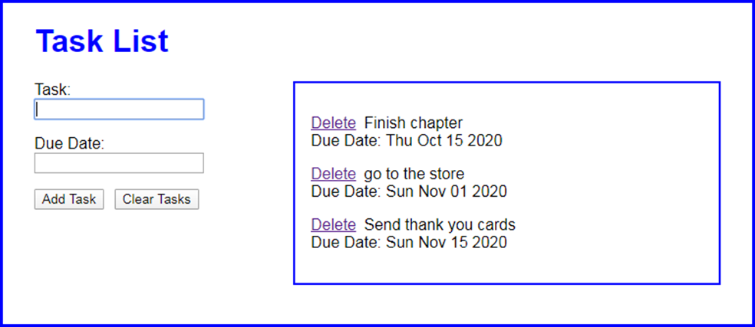
The Task List application

Slide 76
The HTML for the Task List application (part 1)
<body>
<main>
<h1>Task List</h1>
<div id="tasks"></div>
<div>
<label for="task">Task:</label>
<input type="text" name="task" id="task">
</div>
<div>
<label for="due_date">Due Date:</label>
<input type="text" name="due_date" id="due_date">
</div>
<div>
<input type="button" id="add_task" value="Add Task">
<input type="button" id="clear_tasks"
value="Clear Tasks">
</div>
<div class="clear"></div>
</main>

Slide 77
The HTML for the Task List application (part 2)
<script
src="https://code.jquery.com/jquery-3.4.1.slim.min.js">
</script>
<script src="lib_task.js"></script>
<script src="lib_storage.js"></script>
<script src="lib_task_list.js"></script>
<script src="task_list.js"></script>
</body>

Slide 78
Some of the CSS for the Task List application
#tasks {
float: right;
width: 25em;
margin: 0 0 .5em;
padding: 1em;
border: 2px solid black;
min-height: 5em;
}
#tasks a {
margin-right: 0.5em;
}
.clear {
clear: both;
}

Slide 79
The lib_task.js file for the Task List app (part 1)
"use strict";
class Task {
constructor({description, dueDate}) { // uses destructuring
this.description = description;
if (dueDate) {
this.dueDate = new Date(dueDate);
} else {
this.dueDate = new Date();
this.dueDate.setMonth(this.dueDate.getMonth() + 1);
}
}
get isValid() {
if (this.description === "") {
return false;
}
const today = new Date();
if (this.dueDate.getTime() <= today.getTime() ) {
return false;
}
return true;
}

Slide 80
The lib_task.js file for the Task List app (part 2)
toString() {
return `${this.description}<br>
Due Date: ${this.dueDate.toDateString()}`;
}
}

Slide 81
The lib_storage.js file for the Task List app
"use strict";
const storage = {
retrieve() {
const tasks = [];
const json = localStorage.tasks;
if(json) {
const taskArray = JSON.parse(json);
for(let obj of taskArray) {
tasks.push(new Task(obj)); // uses destructuring
}
}
return tasks;
},
store(tasks) {
localStorage.tasks = JSON.stringify(tasks);
},
clear() {
localStorage.tasks = "";
}
};

Slide 82
The lib_task_list.js file for the Task List app
(part 1)
"use strict";
const tasks = Symbol("tasks");
const taskList = {
[tasks]: [],
load() {
this[tasks] = storage.retrieve();
return this;
},
save() {
storage.store(this[tasks]);
return this;
},

Slide 83
The lib_task_list.js file for the Task List app
(part 2)
sort() {
this[tasks].sort( (task1, task2) => {
if (task1.dueDate < task2.dueDate) {
return -1;
} else if (task1.dueDate > task2.dueDate) {
return 1;
} else {
return 0;
}
});
return this;
},
add(task) {
this[tasks].push(task);
return this;
},
delete(i) {
this.sort();
this[tasks].splice(i, 1);
return this;
},

Slide 84
The lib_task_list.js file for the Task List app
(part 3)
clear() {
storage.clear();
return this;
},
*[Symbol.iterator]() {
for (let task of this[tasks]) {
yield task;
}
}
};

Slide 85
The task_list.js file for the Task List app (part 1)
"use strict";
const displayTasks = () => {
taskList.sort();
let html = "";
for (const task of taskList) {
html += "<p><a href='#'>Delete</a>" +
task.toString() + "</p>";
}
$("#tasks").html(html);
// add click() event handler to each <a> element
$("#tasks").find("a").each( (index, a) => {
$(a).click( evt => {
taskList.load().delete(index).save();
displayTasks();
evt.preventDefault();
$("input:first").focus();
});
});
}

Slide 86
The task_list.js file for the Task List app (part 2)
$(document).ready( () => {
$("#add_task").click( () => {
const taskObj = { // object literal
description: $("#task").val(),
dueDate: $("#due_date").val()
};
const newTask = new Task(taskObj); // Task object
if (newTask.isValid) {
taskList.load().add(newTask).save();
displayTasks();
$("#task").val("");
$("#due_date").val("");
} else {
alert("Please enter a task and/or " +
"a due date that's in the future.");
}
$("#task").select();
});

Slide 87
The task_list.js file for the Task List app (part 3)
$("#clear_tasks").click( () => {
taskList.clear();
$("#tasks").html("");
$("#task").val("");
$("#due_date").val("");
$("#task").focus();
});
taskList.load()
displayTasks();
$("#task").focus();
});

